Slide 1
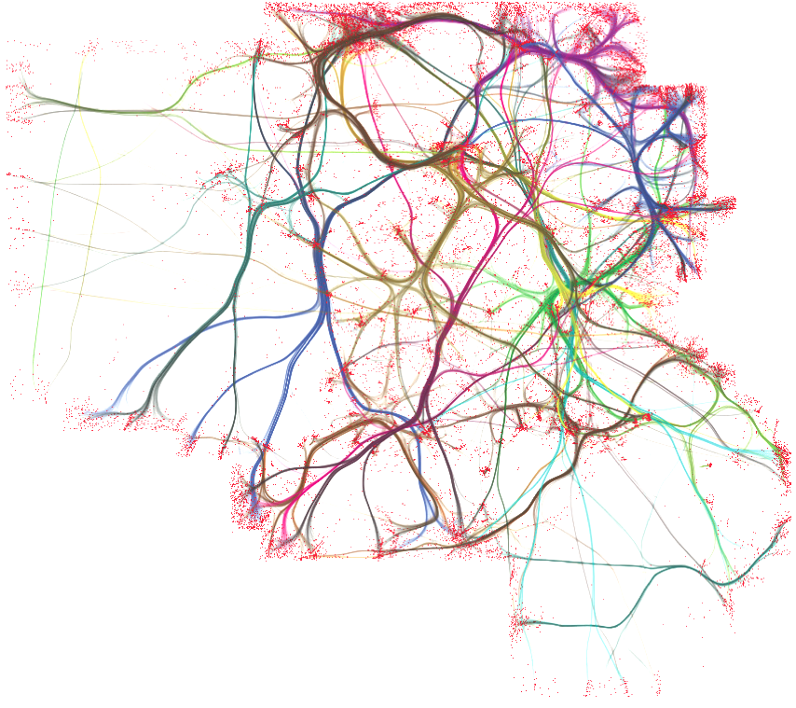


Danbury AI

Slide 2

IS Sponsored By:
https://bitly.com/AS-SW

Slide 3

TensorFlow Workshop
Today we come together to learn about how to use TensorFlow for machine learning applications and other computationally intensive processes that may benefit from such a high performance distributed architecture. We will discuss the overarching ideas underlying TF, but there will be an emphasis on looking at code and getting it to run on each member’s setups. We hope that you come away with a motivation to develop software in the TensorFlow framework and contribute to the awesome open source community.

Slide 4
Introductions
Welcome to Danbury AI! Let’s introduce ourselves. Here are some things we’d like to know:
Name?
Areas of interest?
What do you know about AI?
Current projects?
What are your hobbies? Give us at least one!
What would you like to get out of this meetup?

Slide 5
Overview
Conceptual Overview and Introduction
Setting up TensorFlow ( Windows, MacOs, Linux/Ubuntu )
Beginner MNIST and Deep MNIST
Overview of TF Learn and CNN, RNN, MLP API’s
TensorFlow Implementations
Group code jam: Titanic

Slide 6
Conceptual Overview and Introduction
See Aug Presentation

Slide 7
Setting up TensorFlow
The alternative prefered method is using Docker containers. The problem there is that if you need GPU optimization, non Nvidia-Docker containers cannot access the GPU.
Download Anaconda. Or the minimal version.
Create a conda environment for TensorFlow. WINDOWS CUDA
Install the scientific computing suite, scipy, and jupyter, alongside TensorFlow.
Activate that environment when you run TensorFlow programs.
(optional) Install PyCharm Community Edition. A great free IDE for python. Not open source.

Slide 8
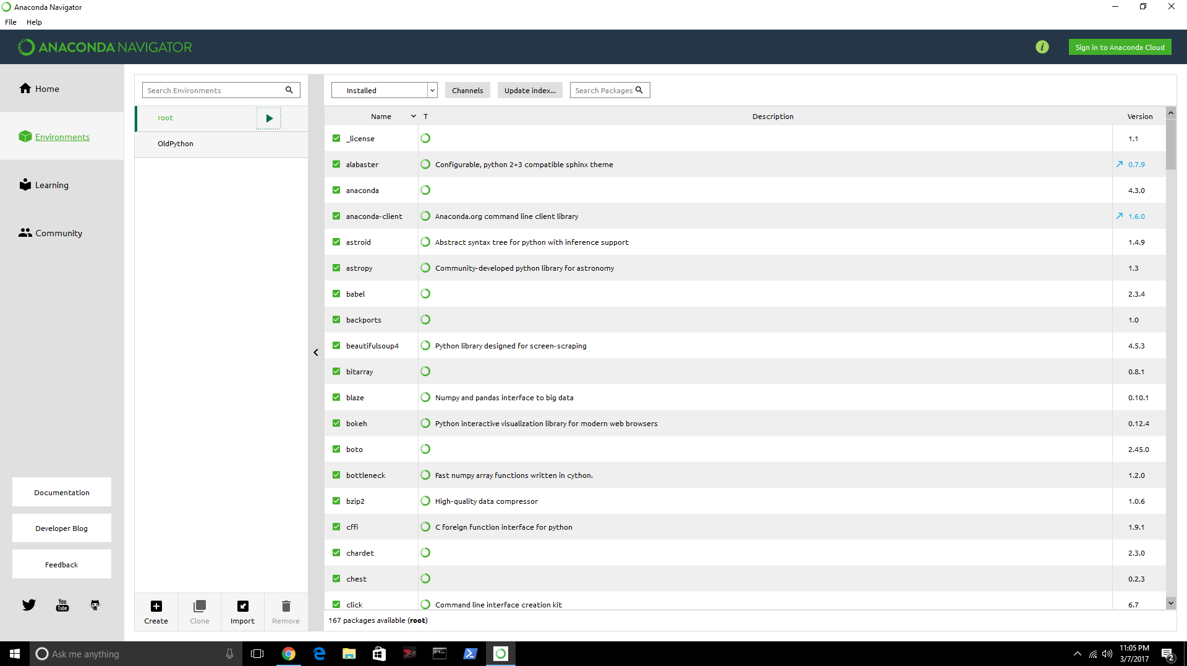

Slide 9

The Easy Way or The Hard Way
Why?
Why?
Low level tensor operations
( matmult, relu )
High level API’s
( Keras, TFLearn )
Backpropagation is a leaky abstraction

Slide 10
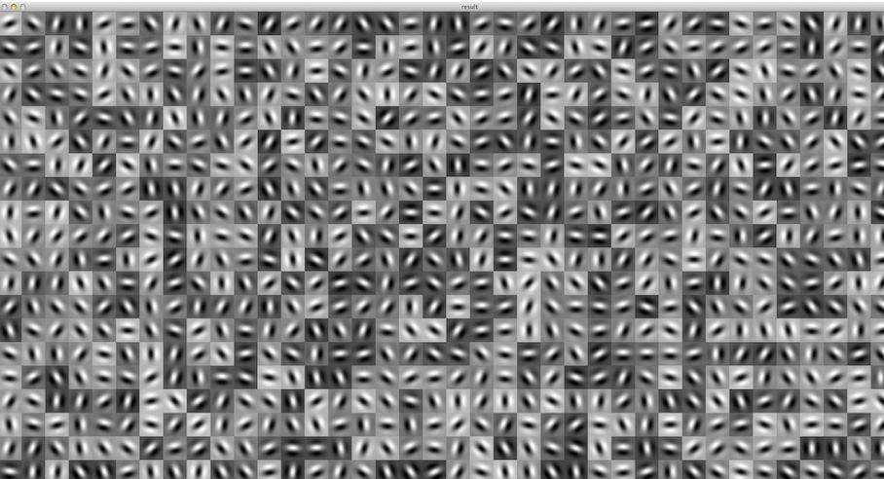
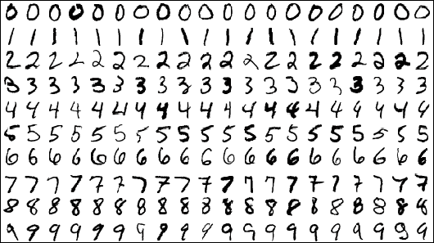
Beginner MNIST and Deep MNIST
From Danbury AI TF Workshop repo ( jupiter notebooks )
Beginner MNIST
Deep MNIST

Slide 11
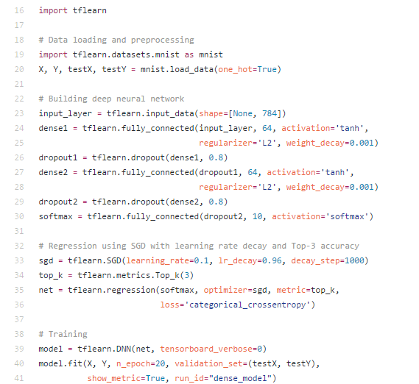
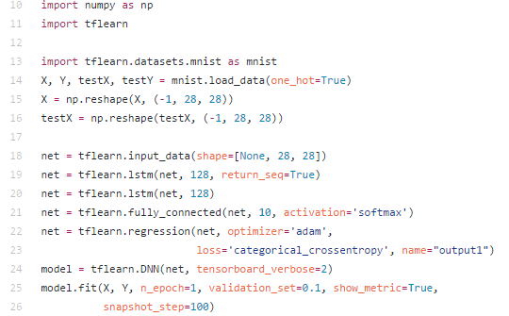
TF Learn
http://tflearn.org/examples/

Slide 12
TensorFlow Implementations
Great examples.

Slide 13

Code Jam
2224 Boarded
1502 Dead
722 Survived
Why?
Predict which passengers survived the tragedy.
Goto: https://www.kaggle.com/c/titanic

